Slide 1
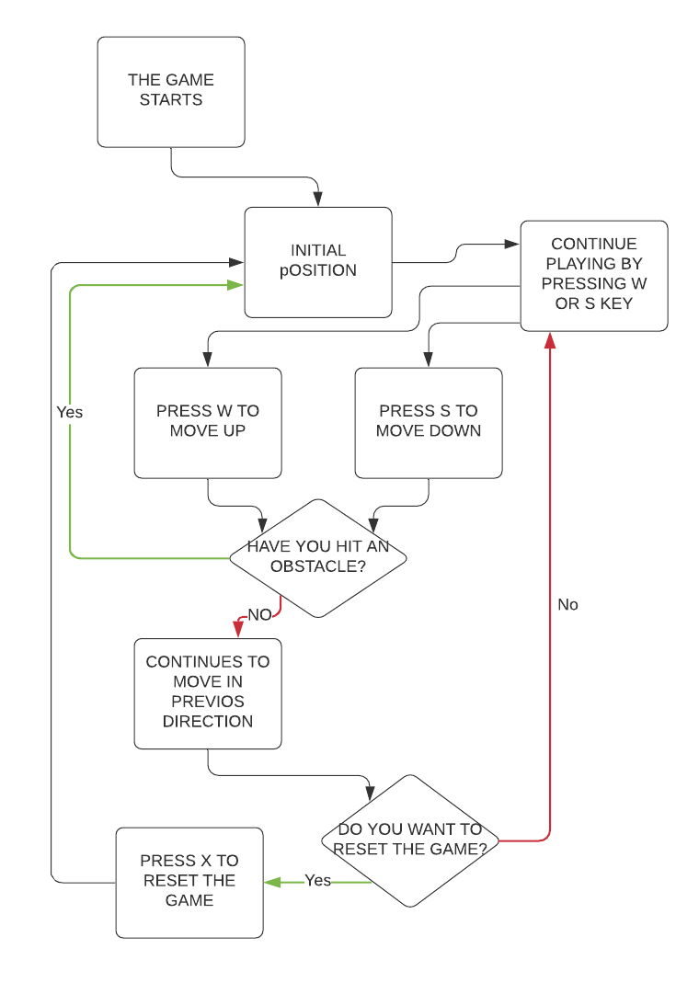
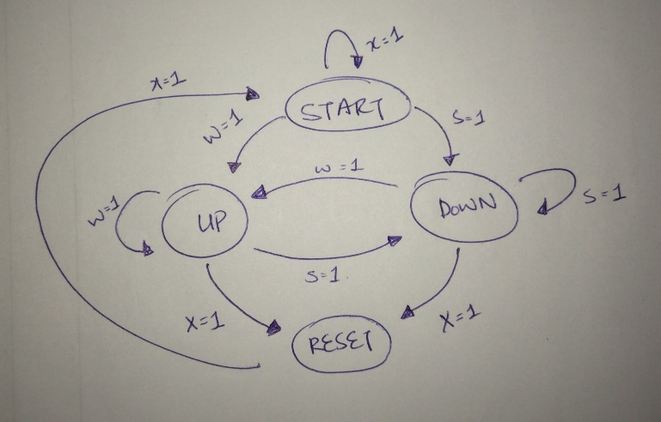
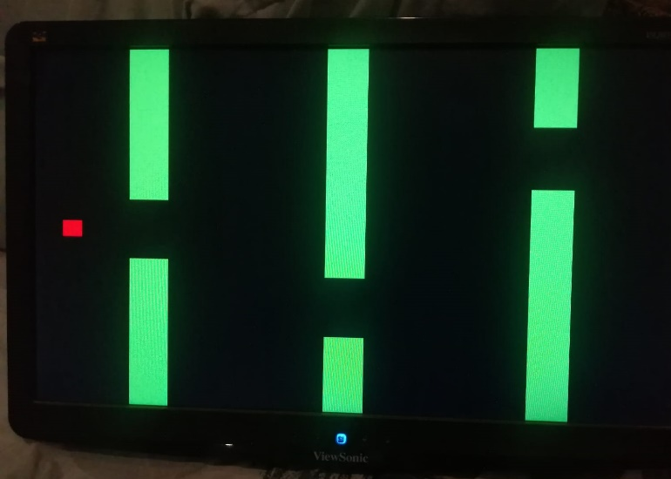
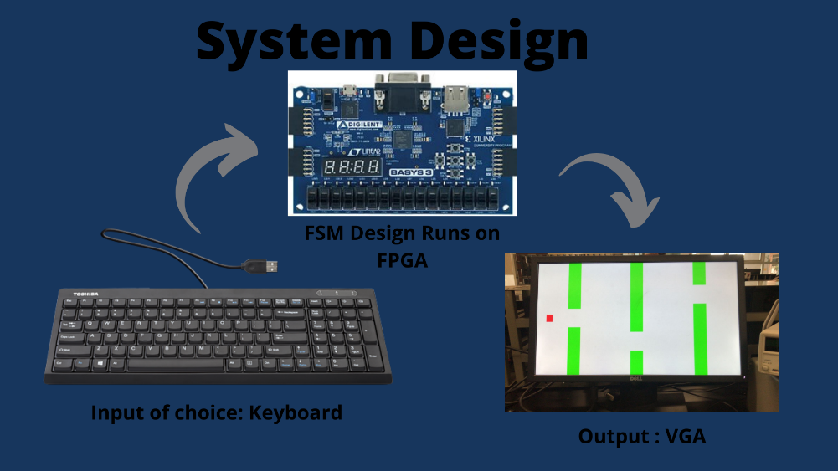
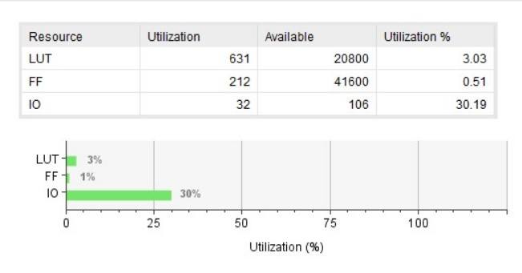
Flappy bird Ali Asghar, Musab Sattar,Azeem Haider,Shahid Mahmood
USER FLOW
Introduction
This project is an FPGA emulation of the game flappy bird, released in 2012. The game went on to be immensely popular. This project tries to recapture the essence of the game with the help of an FPGA board. The project is created using the knowledge and skills taught to us during the Digital Logic Design course. We have used the Artix 7 FPGA board which is connected to the CPU via micro USB. The programming is done on HDL Verilog, which was taught during the course. Input for this project is the keyboard connected to the FPGA board through the USB connecter J2. The key ‘x’ being used to reset the game, key ‘w’ used to move the bird in an upward position and key ‘s’ is used to move the bird downward. The output used is a VGA output where pixels are configured to emulate the game. The project is a Moore model, since, our project's next state is dependent only on the current state of the project.
State Diagram
Hardware Resource Utilization
Results

